Slide 2

Cuando SQL no es suficiente

Slide 3
Problemas
“Variedad” de los datos
Datos no estructurados
Cambios en el esquema
Trata de agregar una nueva columna!
Escalabilidad
Solo agrega un nuevo server

Slide 4

La solución!

Slide 5
NoSQL
Sin esquema
Consistente (eventualmente)
Replicación!
Muucha data!

Slide 6
No todo el NoSQL es igual
Hay 4 principales categorías

Slide 7
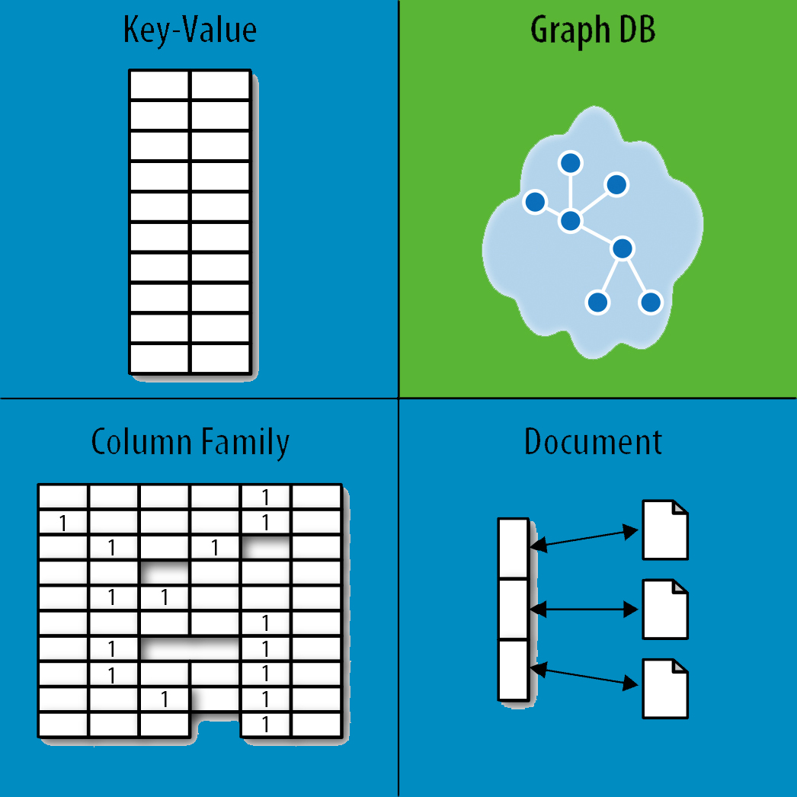

Slide 8
Key Value Stores
Hashtable con una clave única y un puntero a la data
Muy alto desempeño

Slide 9
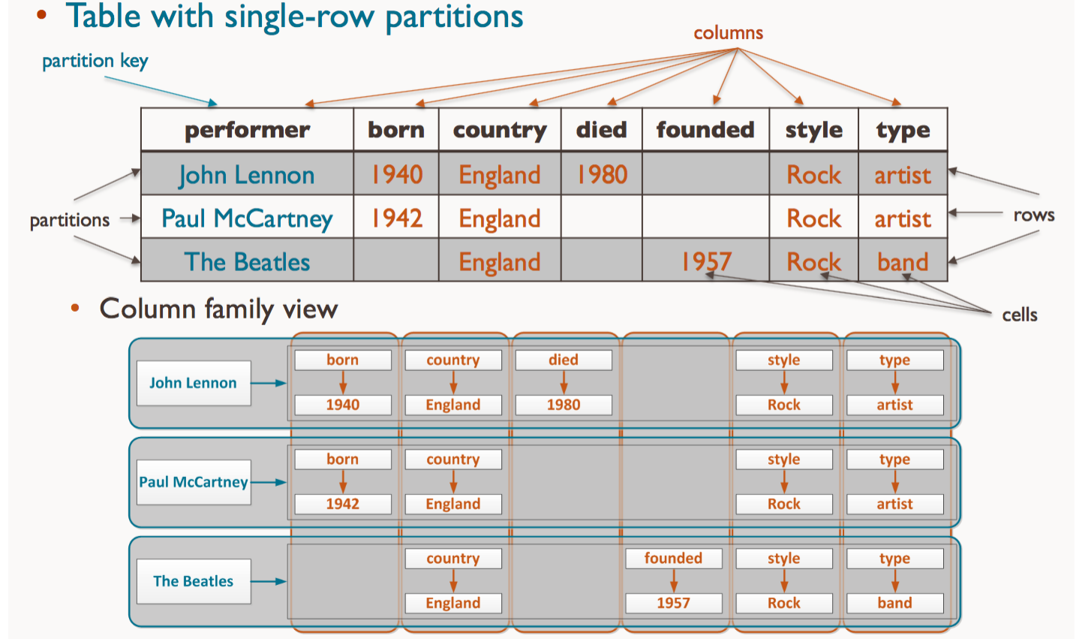
Wide column stores
Rows do not need to have the same number of columns

Slide 10
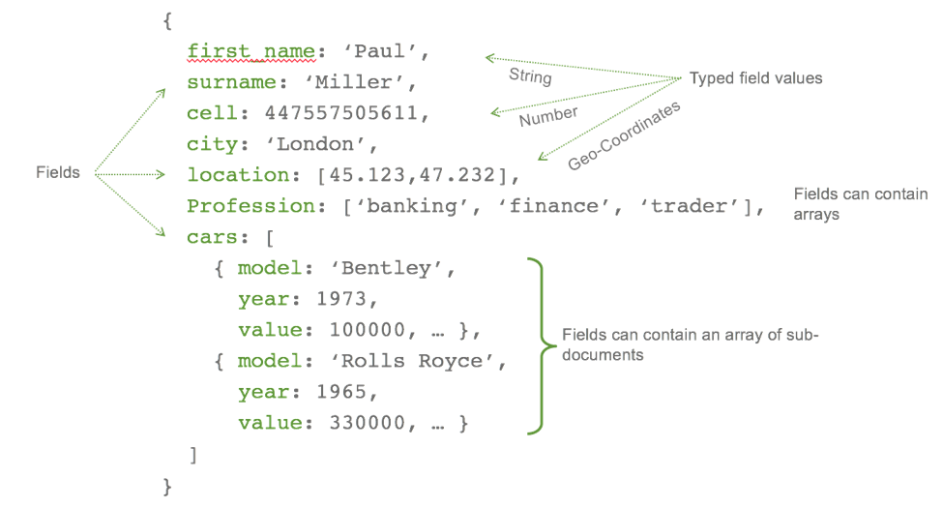
Document Databases
It is like a key-value database, but a document store consists of semi-structured data

Slide 11
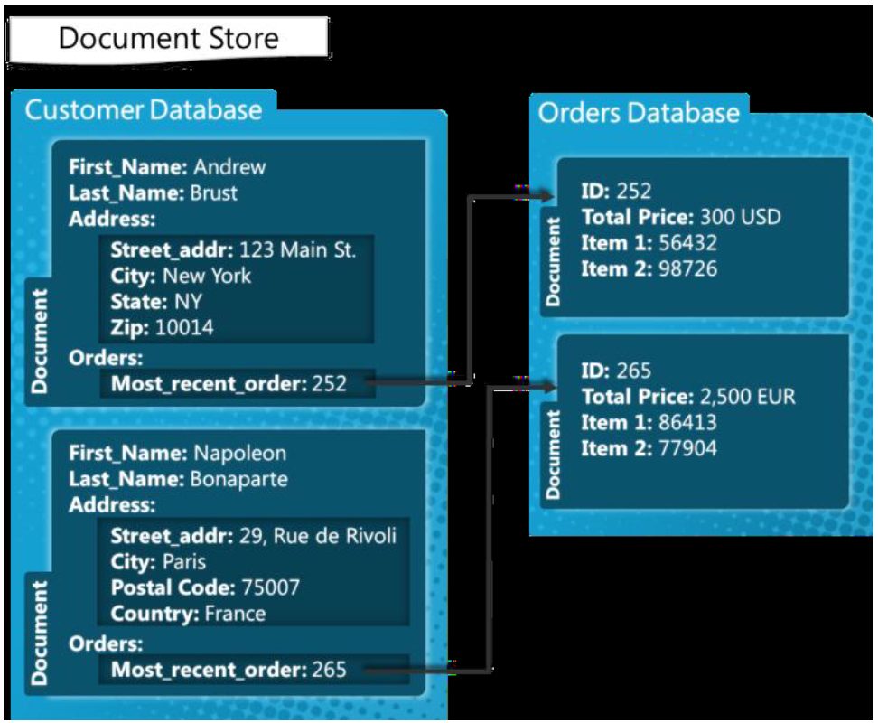
Document Databases

Slide 12
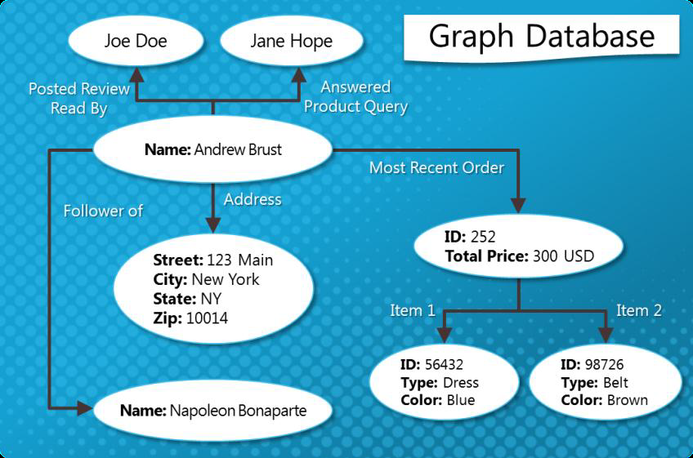
Graph databases
Graph databases recognize entities in a business or other domain, and explicitly track the relationships between them.

Slide 13
Resumen de diferencias
 | SQL Databases | NoSQL Databases
Data Storage Model | Tables with fixed rows and columns | Document: JSON documents, Key-value: key-value pairs, Wide-column: tables with rows and dynamic columns, Graph: nodes and edges
Development History | Developed in the 1970s with a focus on reducing data duplication | Developed in the late 2000s with a focus on scaling and allowing for rapid application change driven by agile and DevOps practices.
Examples | Oracle, MySQL, Microsoft SQL Server, and PostgreSQL | Document: MongoDB and CouchDB, Key-value: Redis and DynamoDB, Wide-column: Cassandra and HBase, Graph: Neo4j and Amazon Neptune
Schemas | Rigid | Flexible
Scaling | Vertical (scale-up with a larger server) | Horizontal (scale-out across commodity servers)

Slide 14
Beneficios
Flexible data models
Horizontal scaling
Most SQL databases require you to scale-up vertically (migrate to a larger, more expensive server) when you exceed the capacity requirements of your current server. Conversely, most NoSQL databases allow you to scale-out horizontally, meaning you can add cheaper, commodity servers whenever you need to.
Fast queries
Data in SQL databases is typically normalized, so queries for a single object or entity require you to join data from multiple tables. As your tables grow in size, the joins can become expensive. However, data in NoSQL databases is typically stored in a way that is optimized for queries. The rule of thumb when you use MongoDB is Data is that is accessed together should be stored together. Queries typically do not require joins, so the queries are very fast.

Slide 15
Desventajas
Lack of standardization, Support and Maturity

Slide 16
https://www.mongodb.com/nosql-explained
https://www.mongodb.com/nosql-explained/nosql-vs-sql
https://docs.microsoft.com/en-us/archive/blogs/usisvde/getting-acquainted-with-nosql-on-windows-azure
https://www.freecodecamp.org/news/nosql-databases-5f6639ed9574/
https://medium.com/@mark.rethana/introduction-to-nosql-databases-c5b43f3ca1cc

Slide 17


